Slide 1
2020 $tart $mart Teacher Summit Panel Discussion
The New Workforce - Trends Influencing College & Career Preparation

Slide 2
Panel Moderator
Jeff Bossard
Assistant Principal
Itineris Early College High School
W!SE Nationally recognized Financial Literacy Educator

Slide 3
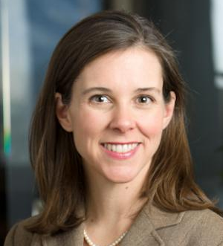
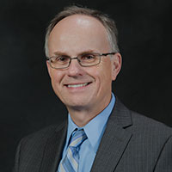
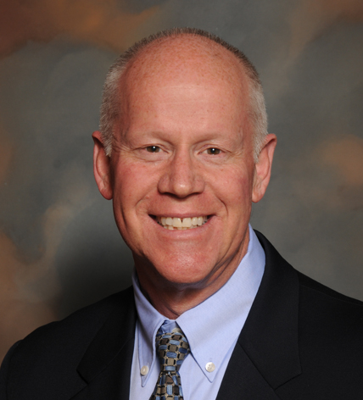
Panelists
Stephanie Frohman
Director of Strategic Initiatives
Economic Development Corp. of Utah
sfrohman@edcutah.org
Dr. Orn Bodvarsson
Dean, Bill & Vieve Gore
School of Business
Westminster College
obodvarsson@westminstercollege.edu
Richard Haskell
Associate Professor – Finance
Bill & Vieve Gore School of Business,
Westminster College
rhaskell@westminstercollege.edu

Slide 4
Six months ago…

Slide 6
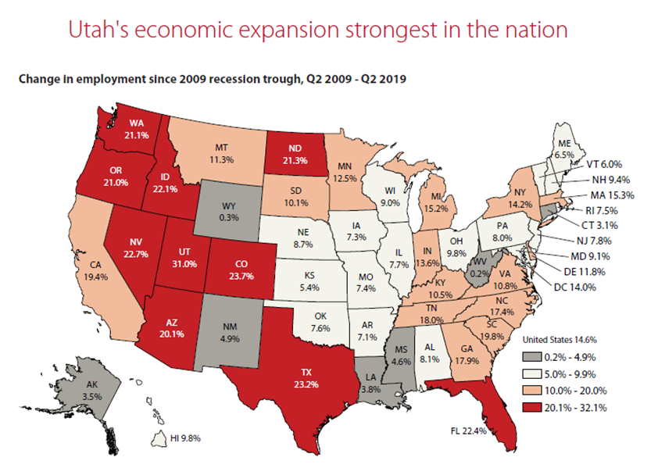

Slide 7
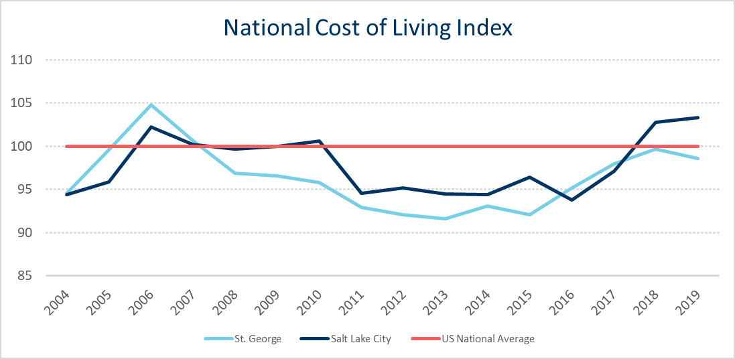
Source: The Council for Community and Economic Research

Slide 8
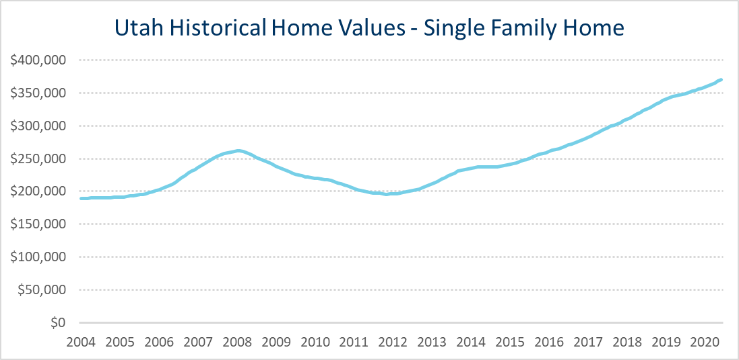
Source: Zillow
Utah's historical home values have gone up by 96% since 2004

Slide 9
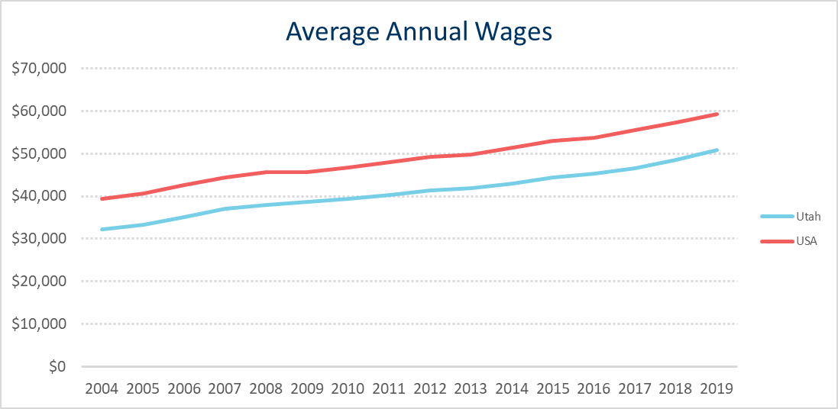
Source: Bureau of Labor Statistics
Utah's average annual wages have gone up by 58% since 2004.

Slide 10
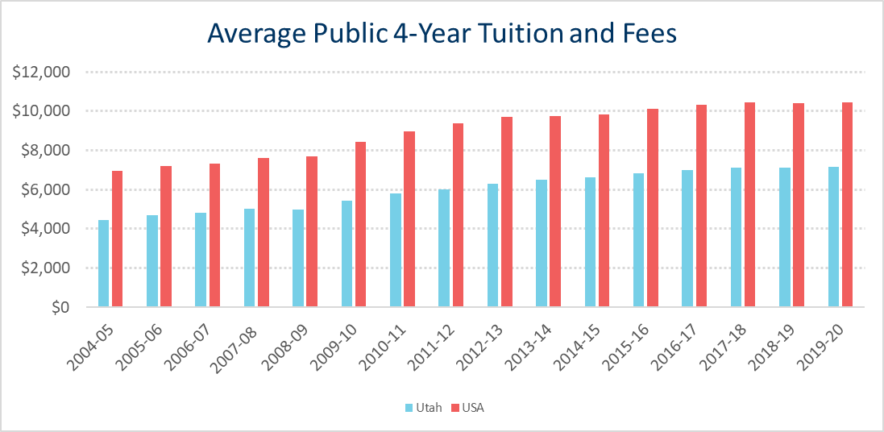
Source: The College Board, Annual Survey of Colleges.
Note: Average tuition and fee prices are weighted by full-time enrollment.
Cost measured in 2019 Dollars
Utah's average tuition and fees have gone up by 61% since 2004
USA's average tuition and fees have gone up by 50% since 2004

Slide 11
How quickly things change.

Slide 13
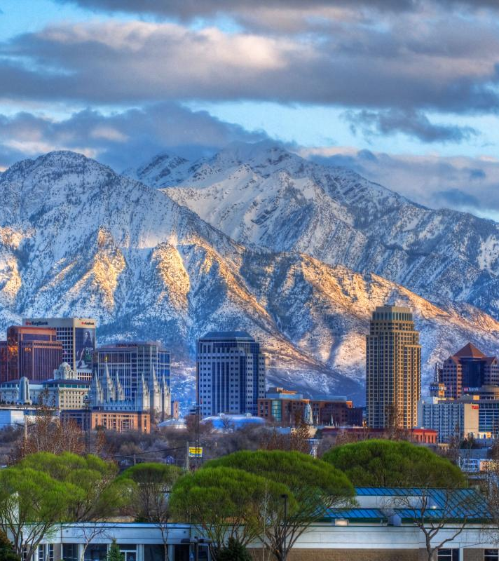
Utah Leads Together: CARES investment in Utah’s economic future, including broadband infrastructure, transportation, outdoor recreation and more.
Utah recovers faster: Already leading the nation in % unemployment in the recovery. (#2 in June)
Rural ROI: Remote work “works” may bring more jobs off the Wasatch Front.
Inland Port: More opportunities in logistics and re-shoring is good news for Utah.
HAFB/GBSD: Northern Utah poised for explosive growth around Hill AFB.
Point of the Mountain: Next generation of Silicon Slopes ready for takeoff.
Utah Leads Together: CARES
investment in Utah’s economic
future, including broadband
infrastructure, transportation,
outdoor recreation and more.
Utah recovers faster: Already leading the
nation in % unemployment in the recovery. (#2 in June)
Rural ROI: Remote work “works” may bring
more jobs off the Wasatch Front.
Inland Port: More opportunities in logistics and
re-shoring is good news for Utah.
HAFB/GBSD: Northern Utah poised for explosive
growth around Hill AFB.
Point of the Mountain: Next generation of
Silicon Slopes ready for takeoff.
The Silver Lining

Slide 14
College Preparedness

Slide 15
Learning years
fuel the
earning years.

Slide 16
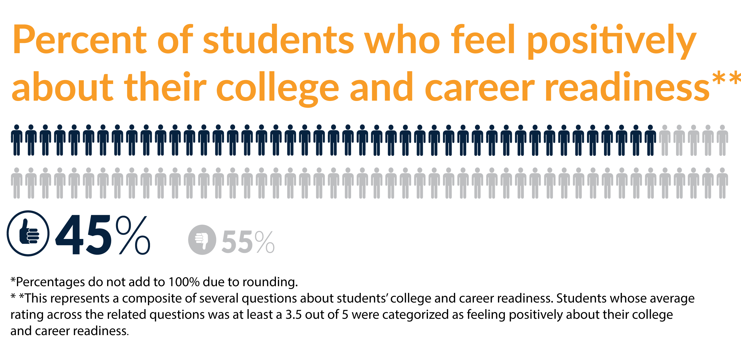
Youth Truth Report: Learning from Student Voice: College and Career Readiness 2016,

Slide 17
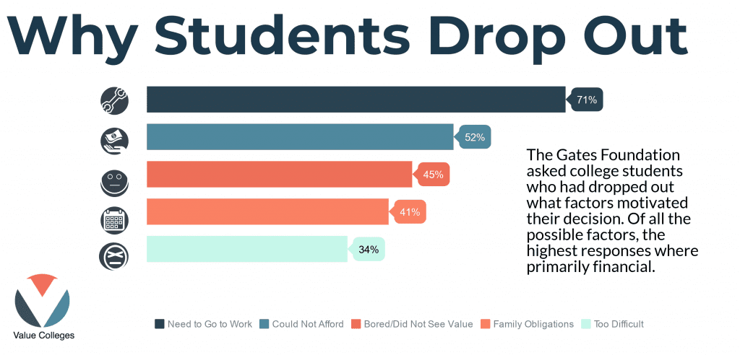
Gates Foundation, 2010.

Slide 18
Post High School Options
Job Training
Vocational School
Apprenticeships
College Education
Associate’s Degree
Bachelor’s Degree

Slide 19
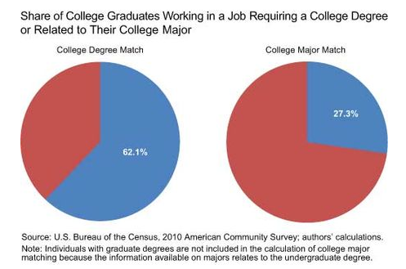
Only 27% of college graduates work in a job related to their
college major.

Slide 20
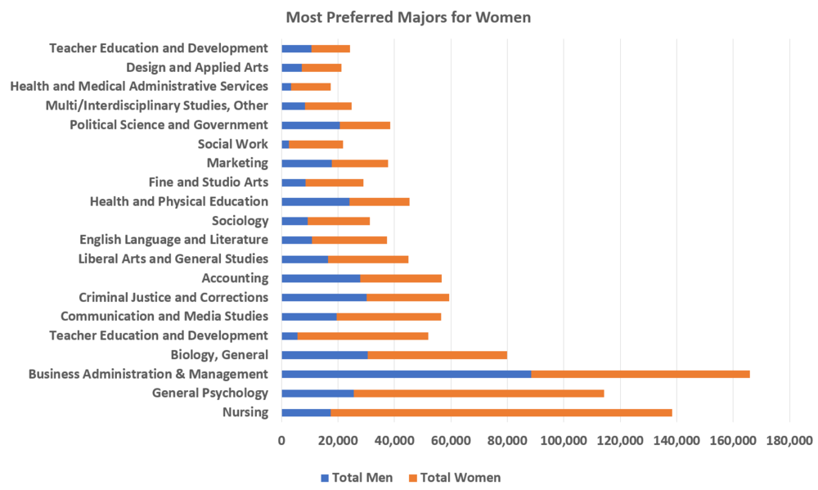
College Factual Report, 2017

Slide 21
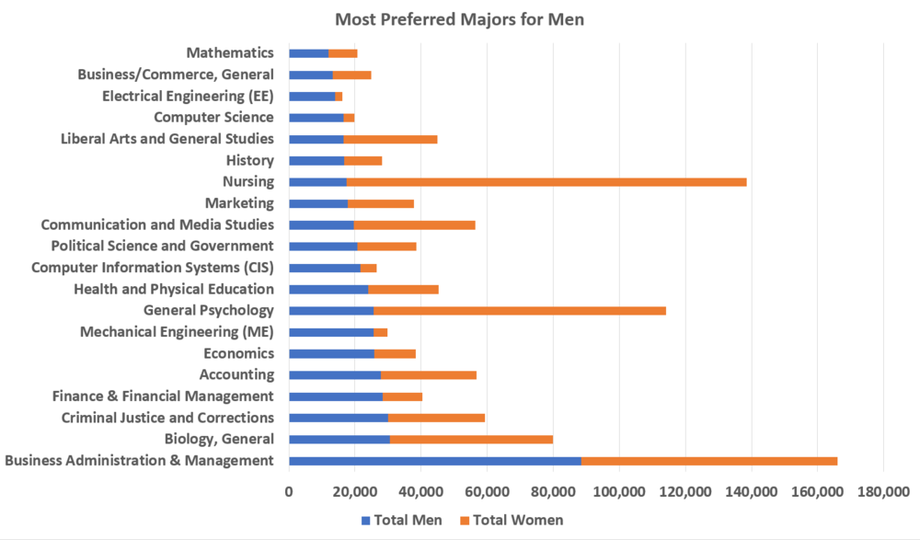
College Factual Report, 2017

Slide 22
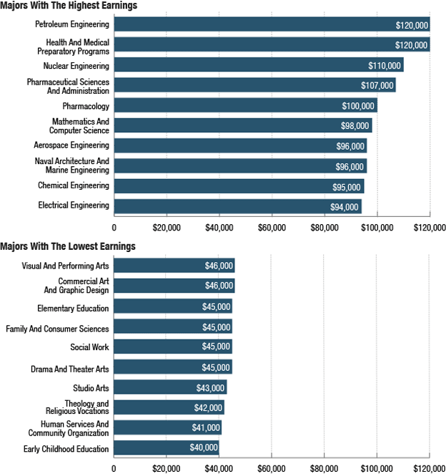
NPR Planet Money, 2013

Slide 23
College & Career Planning is a Series of Financial Decisions
Higher Education is an investment.
How can we help students look for the ROI on that investment?
What factors should students consider when choosing between college, vocational training, etc.?

Slide 24
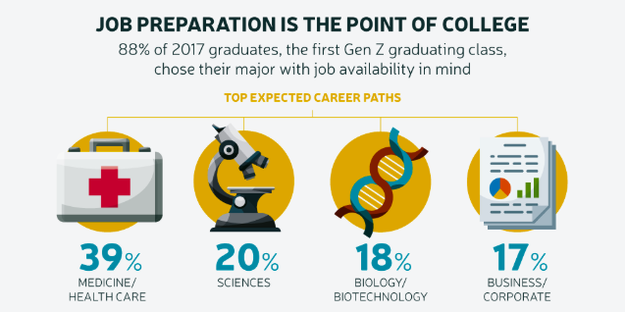
Next Gen Personal Finance

Slide 25
Career Planning

Slide 26
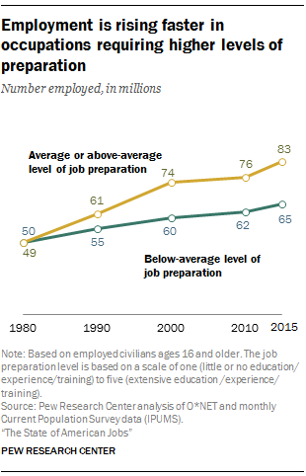
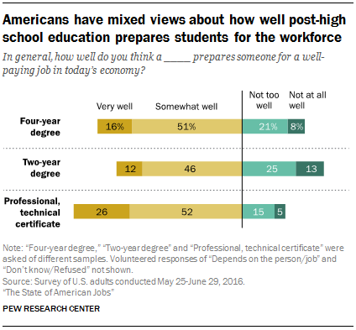

Slide 27
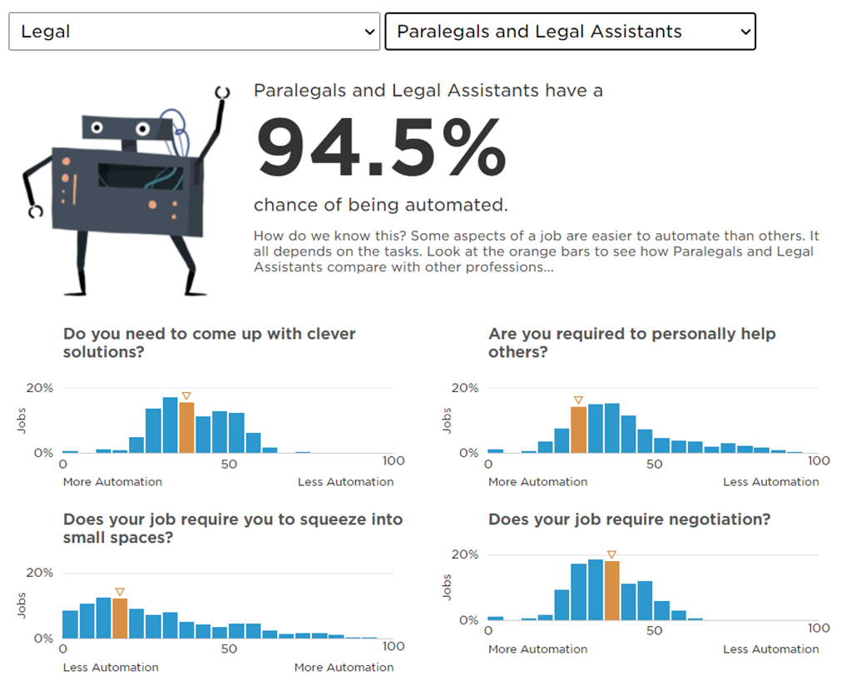
Jobs and Automation

Slide 28
Career Planning During and Post
COVID-19

Slide 30
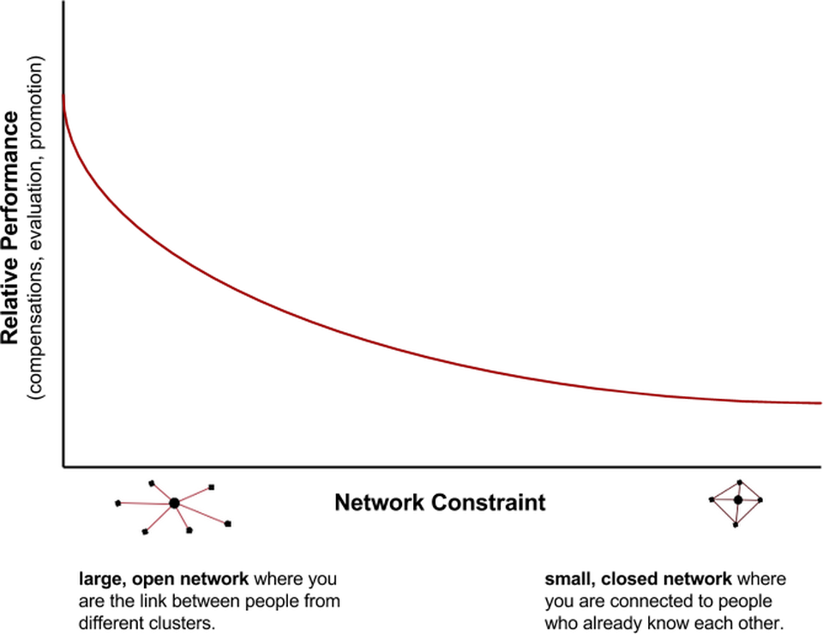
What's the #1 predictor of career success?
Answer: Having an open network.
Next Gen Personal Finance

Slide 31
“Every success story is a tale of constant adapting, revision and change.”
Richard Branson

Slide 32
Q & A

Slide 33
Important info
Roll will be taken throughout the Summit.
You must attend three full sessions to receive a stipend.
Complete the follow up assignment at utahjumpstart.org/2020Summit to receive 0.5 USBE credit.
LAST CALL!
Confirm your address in Eventbrite. Checks may be delayed or forfeited if your address is missing.
Confirm your CACTUS number in Eventbrite.

Slide 34
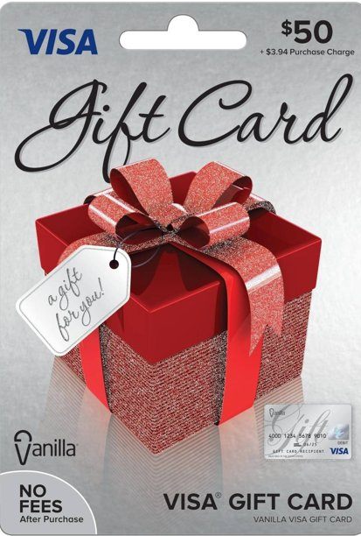
Homework
Survey
Relicensure points
Resources
utahjumpstart.org/2020Summit

Slide 36
Question of the Session
Answer to win a
my529 Prize Pack!

