Slide 1
K-6 Financial Education - STEM Activities for Students
Amber Lowry
Freedom Preparatory Academy

Slide 2
Importance of STEM in the classroom
STEM stands for Science, Technology, Engineering, and Mathematics.
STEM is empowering to students.
It creates critical thinkers and helps students increase their understanding of science.
It allows for much higher hands on participation among your students.

Slide 3
Why Financial Literacy in Elementary?
The understanding of money can never be taught too early in the elementary grades.
Preparing young students with the basic skills needed to make smart financial choices now, will help them make smarter choices in their future when these skills are truly going to be needed.
Many financial problems that people are dealing with today, could be due to their lack of financial education when they were young.
The following lesson units are comprised of different financial literacy standards and how they can be incorporated into the standard subjects within the classroom.

Slide 4
Kindergarten
Teach your students how to identify U.S. currency.
Help them learn how money has been used.
Help them learn how we use money today.
Teach them the purposes of banks and credit unions.

Slide 5
Kindergarten
Vocabulary:
Bill (dollar bill)
Coin (Quarter, dime, nickel, and penny)
Pattern
Money
Similarities
Differences

Slide 6
Kindergarten 2 day lesson/STEM activity
Discuss where money comes from and how it’s made.
Ask the students what the coins are as you hold them up one by one.
Ask them what their similarities and differences are.
Ask them if they know how to earn more money.
Students will receive one of each coin. They will learn how to name each coin based on physical characteristics; Largest = quarter, smallest = dime, brown = penny, medium silver = nickel, etc.
Students will find how many ways you can create 10 cents. (10 pennies, 1 dime, 2 nickels)
Students will create coin rubbings of each different coin and then compare the rubbing to the actual coin.
Students will be given colored pencils that match the color of the coins, a blank white piece of paper, and the four coins.
Students will rub their fingers on the paper that’s covering the coin to see what it feels like. Then they’ll take the colored pencil and make the coin rubbing.

Slide 7
First Grade - Goods and Services
Integration of financial literacy and Utah Core Social Studies.
Distinguish between goods and services.
Three smart ways of using money; saving, spending, and sharing.
Goods and services within a community.
Differences between wants and needs.

Slide 8
First Grade - Unit Vocabulary
Share
Save
Buy
Goods
Service
Community
Donate
Giving
Want
Need

Slide 9
First Grade - 4 day Unit Lessons
-Goods and services in Our neighborhood - Identify at least 2 goods and services in their neighborhood, and distinguish between goods and services. Content: Reading literature If You Give a Mouse a Cookie. Goods and services examples in the community and daily life, and creation of a model of goods and services that students are familiar with.
-Economic choices: Wants vs. needs - Identify wants/needs and their differences, be able to categorize wants and needs, make wise decisions through a scenario practice. Content: Game of life; making choices between wants and needs game. Modeling - identifying what I want and what I need. Students categorize their own wants and needs.
-Saving for a rainy day - Identify what it means to save, what different situations there are to save money, and the three smart ways of using money; saving, spending, and sharing. Content: Sesame Street video with Elmo describing the importance of saving money. Creating a saving/spending/sharing box.
-Sharing and giving to others - Identify what sharing money would look like and the different ways in our community that we can share what we have even if it isn’t money. Content: Reading Literature, sharing and giving experiences, mathematical connection, post-sharing discussion.

Slide 10
First Grade - STEM activities
Students will create a project independently.
The project will be the creation of a neighborhood that must include the following components
Student home
At least 2 good or services
Roads.
Students may be creative but need to demonstrate their understanding of what goods and services are in context of a neighborhood. They can either draw it or use materials to make it 3-D
Students are given $19 in play money and while going through the slideshow game they will either need to buy things or pay for something. If they run out of money, then they must wait until an “earning” opportunity presents itself to earn more money.
Have a discussion about whether or not you had enough money and why. Spending is fun, but you must first get what you need before you can get what you want.

Slide 11
STEM activities continued
Students will create their own “piggy banks” to keep their class earned money in for the duration of the unit.
Requirements for the box are as follows;
Students must have one section for each category; spending, savings, and sharing.
Each section must be neatly labeled.
Money must be organized in each section and work must be neat.

Slide 12
Second Grade - Earning and Saving
Integration of financial literacy with history and geography.
Demonstrate map skills by identifying and locating continents, countries, oceans, landforms, and bodies of water. Identify landmarks on a map, and explain why different areas of the world have different ways of earning income.
Demonstrate basic adding and subtracting skills, basic knowledge of producing a service to earn money, and knowledge on how to save money.
Distinguish the difference between and the importance of wants/needs, add amounts up to $50, and Categorize information on a T-chart.

Slide 13
Second Grade - Unit Vocabulary
Continent
Country
Sea
Ocean
Island
Immigrant
Saving
Spending
Producer
Consumer
Want
Need

Slide 14
2nd Grade - 3 day Unit Lessons
Earning Income in Japan - Students will gain an understanding of how physical characteristics of places and regions affect people’s activities in the area, and why different areas of the world have different ways of earning income. Use artifacts, photographs, maps, biographies, etc to gather information about the work that people performed to make a living in the past, and explain how jobs in the past are both similar and different from today’s jobs and how science and technology have changed the daily lives of people. Content: An island with a big industry for fishing, types of fishing and different money that was made. Fishing inventions and pictures.
Saving for America - Describe how producers and consumers work together in the making of goods and services. Demonstrate basic knowledge of producing a service to earn money. Differences in value of money from the past to now. Content: Reading literature, get me to America game, savings worksheet, map/globe.
Building a Life - Describe the choices people make in using goods and services by giving examples, define wants and needs and the differences between them. Students must brainstorm with partner to decide what they would absolutely need to build a life in America after making it there with only the clothes they have on and nothing else. Content: Writing paper, wants vs. needs activity chart, $50 to spend on needs to help build their life.

Slide 15
2nd Grade - STEM Activities
Students will create their own fishing inventions in groups based on what they learned about which methods of fishing made the most money. Materials;
String
Straws
Paper bags
Foil
Paper
Any other item around the classroom that is available.
Students play the Get me to America game in groups of 4 or 5. Students will pass the deck of cards around drawing one at a time. After reading the card they will record the money that was earned, spent, or lost on their tracking my savings sheet. They return the card and continue playing until they have the needed amount of $30 in order for them to make it to America. They must complete the step by step of adding and/or subtracting on their savings sheet.

Slide 16
Third Grade - Not Made of Money
Integration of financial literacy with ELA, Social Studies, and Science
Explain how goals, decision making and planning affect personal financial choices. Use rational decision making to set and begin financial goals.
Students will understand that money makes it easier to trade, borrow, save, and compare the value of goods and services.
Explore the components of Utah’s economy.
Students will understand that income for most is determined by their education, work experience, and job skills.
Students will be able to explain how their lives would be more difficult in a world with no money. They’ll be able to explain how they can benefit themselves and others by developing special skills and strengths.

Slide 17
Third Grade - Unit Vocabulary
Allowance
Barter
Salary
Wages
Money
Savings

Slide 18
Third Grade - Unit Lesson
Students will be able to identify potential jobs they could do to earn money, and analyze the importance of earning income to acquire goods and services. Learn the importance of money as a means of trade.
Money as a means of trade - Students name things they wish they could have and then explain the different ways they could get these items or services. Ask students if there are ways to obtain the items without using money to pay for them.
Multiple means of representation - Have students draw a picture showing a job that they could do. Have them write a narrative about a job or skill that they have. Have students play charades by acting out different jobs. Finish with a discussion of how the students can improve their job skills to do their chosen jobs and how certain leading jobs normally earn more money..

Slide 19
3rd Grade - STEM Activities
Fin. Literacy and Science Integration - Taternaut drop
Students will be given a budget that they can purchase materials to create a cushion for their potato that will be dropped 3 feet. Students are trying to keep the potato from breaking. Students will discuss for a few minutes in groups what they believe will be the best way to cushion the potato based on how much ‘money’ they have to spend on materials. ($500). 4 cotton balls are $200. A sheet of aluminum foil is $250. A sheet of wax paper is $200. 4 pipe cleaners are $50. One styrofoam cup is $200. A balloon is $200. A sheet of bubble wrap is $250.
Fin. Literacy and Science Integration
Students will create a shoebox habitat for the ecosystem unit of study for third grade. They must keep a running tab of how much they spent in creating their habitat. Students will use their ‘class money’ to purchase the items that will be needed to build their shoebox.
Materials: shoeboxes, construction paper, tissue boxes, glue, clay, etc.

Slide 20
Continued..
Students will choose their items and create a type of protective suit for their potato. Teacher will use a yardstick to measure the drop of the potato.
Once the first round is done, students will be given $200 more to make any changes to their potato or add any more materials to help protect it from the drop.
Students will learn that what you choose to buy is important for not only their taternaut, but for themselves as well.

Slide 21
Fourth Grade - Smart Financial Choices
Integration of financial literacy with science, ELA, and math.
Students will be able to explain the meaning of a problem, plan and choose a pathway for a solution. They will be able to make sense of quantities and their relationships to problem situation, be able to identify mathematical elements of a situation and create a model to show the relationship, clearly identify a problem and solve it using knowledge of money, communicate effectively using science language while using the scientific method, will understand how saving money can improve financial well-being, and be able to make smart spending decisions by using reliable resources when making financial decisions.
Describe how paper towels are created to improve their absorbency.
Explain what embossing is and why it’s important in the absorbency of paper towels.

Slide 22
Fourth Grade - Unit Vocabulary
Water Molecules
Cellulose Fibers
Absorbent
Engineering
Ratio
Data
Savings
Finances
Embossed

Slide 23
Fourth Grade - 4 Day Unit Lessons
Science of Engineering - Open up students’ minds about what it takes to be an engineer and the importance of it. Explain how based on the way things are engineered will change how well they do their job. Activate prior knowledge of Chinese dynasties and learning about the creation of paper. Content: Reading Literature, microscopic pictures of different paper towels, teacher demonstration of how much water that one paper towel can absorb compared to a different paper towel.
Absorbency experiment- Students will be put into groups and given a price list sheet of different brands of paper towels. They must figure out how much each sheet costs based on how many sheets there are and how much the entire roll costs. Students will conduct the experiment and find the cost ratio between different paper towels to figure out which one soaks up the most water to figure out which brand of paper towel is actually the smartest buy in the long run of cost.
Ratio comparisons - Students will compare their data to figure out which brand of paper towels is the smartest financial choice when deciding what brand to choose based on cost.
STEM ACTIVITY DAY 4

Slide 24
4th Grade - STEM Activities
Students will conduct multiple trials of the absorbency experiment to find the ratio of paper towel brands. Example: 2 sheets vs. 1.5 sheets to soak up the same amount of water. The students will then transfer the ratio of sheets to ratio of cost to figure out which is less expensive overall.
Students will gain hands on experience by having the chance to emboss different materials within the classroom. They will get to use an embosser to make their own imprint in their notebooks or on a piece of paper.
(There are many different types of embossers)
I had a custom one made that had the grade I was teaching with my last name.

Slide 25
Fifth Grade - Building Bridges
Integration of financial literacy in Language Arts and Social Studies.
Students will understand basic financial concepts while learning about history. They will gain an understanding of the basic ideas of the Industrial Revolution and how it changed the United States.
Develop a plan for designing and building a bridge, learn how to track earnings on a table, and understand that spending choices affect outcomes.

Slide 26
Fifth Grade - Unit Vocabulary
Industry
Innovation
Earnings
Spending plan
Income
Urbanization
Bridge
Beam
Pier
Span

Slide 27
Fifth Grade - 3 Day Unit Lessons
Industrial Revolution and Income - Develop a system for keeping and using financial records. Students are paired and given time to complete the given tasks to ‘earn’ money in order to purchase supplies for building their bridges. Students will track earnings on a financial table.
Types of Bridges - Understand that the 19th century was a time of incredible change and growth for the U.S. Learn about the economic growth during this time period. Students explore different bridges in the U.S. and read articles related to different types of bridges and begin coming up with ideas for their own bridge.
Building Bridges - Develop a plan for designing and building a bridge, understand the effect of spending choices. Collaborate and communicate effectively with a partner and solve problems related to building a model. Allotment of funds is given and students must make smart financial choices for what materials they will need to build a stable and safe bridge.

Slide 28
Fifth Grade - STEM Activity
Building a Bridge
Students earn money through the completion of tasks to gain an allotment of funds in order to buy supplies for their bridge to be built. Students purchase supplies for their bridge, (A teacher or capable student may act as supplier)
Students design and build a bridge that is approximately half as wide as their desk and has 3 sets of
piers. Piers need to be taller than an unsharpened pencil (It needs to be tall because boats would need
to pass under it in real life.)
Have students decide on a purpose for their bridge and make a plan for features it will include.
Explain that bridges sometimes become landmarks in a city, so they need to look beautiful.
Explain that bridges also need to be very stable to keep people and goods safe.

Slide 29
Sixth Grade - The French Revolution and Taxation
Integration of financial literacy in History.
Students will be split by role cards: 1 King Louis XVI, 1 Queen Marie Antoinette, 1 Controller-General, 3 Members of the Clergy, 3 Noble Lords, and 21 Peasants
Apply communication strategies when discussing financial issues. Understand people are required to pay taxes, for which they receive government services.
Understand the relationship between income level and income tax liability.
Describe how taxes were being used during the French Revolution; paying military, the national debt, and the extravagant lifestyle of the king and queen.

Slide 30
Sixth Grade - Part 1 lesson activity
Part 1 - Peasants produce food - Explain that at this time in France, food production was critical to the stability and well-being of the French Society. It was up to the peasants to work hard and produce food for the nation. Peasants that are not working hard will “starve” and lose points for this activity. Each peasant is responsible for producing 25 tokens of food.
Part 2 - Peasants pay taxes - The Noble Lord of each manor collects all food tokens from the peasants. The tokens are counted by the Noble Lord. The clergy members visit each table and collect 10% of the tokens for tithes of the church. The Controller-General then takes 50% of the rest of the tokens as taxes for the government and shows the tokens to King and Queen. The lord of each manor then takes half of the rest of the tokens as a tax for protection of the peasants. The remaining taxes are then split evenly between each of the peasants.
Part 3 - An announcement is made - “Fellow citizens, though we have collected taxes this year, France is still in a grave financial crisis. The king and queen need the full support of French citizens to resolve this problem. I ask you, citizens, to consider how you can help your country.” For now the peasants don’t need to do anything but they should be aware that they may have to do something drastic soon.

Slide 31
Sixth Grade - Part 2 lesson activity
Step 1 - Pass out role cards and the King makes an announcement of a financial crisis and how to solve it. The 3 Estates are assigned to create proposals to France and its people on how to solve this horrible economic crisis.
Step 2 - Estates meet and decide how they’re going to vote; either by the whole estate or by individual heads. Estates create a banner with their slogan and symbol. Draft a proposal to solve the financial crisis.A spokesperson from each estate kneels in front of the king and queen to state their proposal.
Step 3 - King makes an announcement that he will continue their existing form of taxation to solve the financial crisis and the estates vote for or against it.
Step 4 - Famine has spread through the land and all tokens but one is taken from the peasants. Peasants are angry and most of them join up with members from the first and second estates to split from the current system and start their own government. Once this group is split, the Revolution has begun.

Slide 32
Sixth Grade - STEM Activity French Cannon
The cannon will be tested for distance, accuracy and ability to knock over a tower of cups.
Students go to https://www.sciencebuddies.org/stem-activities/cotton-ball-launcher#summary for instructions on how to build the cannon.
Students have a budget for purchasing materials for their cannon. Students have $500 to start, then $200 additional to finish the build. They can spend it however they think is best.
Toilet paper tubes $100
Rubber bands $150
Pencil $50
You can decide your prices depending on supplies available. Prices might have to be adjusted depending on supply and demand.
Test cannons for distance. Have each group launch 3 cotton balls and take the average of the 3 launches.
Test for accuracy. This can be done by placing a target on the wall and launching the cotton ball from behind a line at the target. Or you can place a cup on the floor and students need to launch into the cup. Points are given for how close the cotton ball hit the bullseye.
Test for destroying a wall. Wall could be made out of playing cards, plastic cups or jenga blocks depending on the resources available in your classroom.

Slide 33
Resources
For full detailed lesson units and activities with attached resources go to canvas commons; Financial Literacy - K-8 STEM units.
https://www.sciencebuddies.org/stem-activities/cotton-ball-launcher#summary
https://freedomprep.instructure.com/courses/2931
https://www.jumpstart.org/what-we-do/support-financial-education/standards/
https://www.financialeducatorscouncil.org/why-is-financial-education-important-for-youth/
https://www.wellsfargo.com/financial-education/

Slide 34
Q & A

Slide 35
Important info
Roll will be taken throughout the Summit.
You must attend three full sessions to receive a stipend.
Complete the follow up assignment at utahjumpstart.org/2020Summit to receive 0.5 USBE credit.
LAST CALL!
Confirm your address in Eventbrite. Checks may be delayed or forfeited if your address is missing.
Confirm your CACTUS number in Eventbrite.

Slide 36
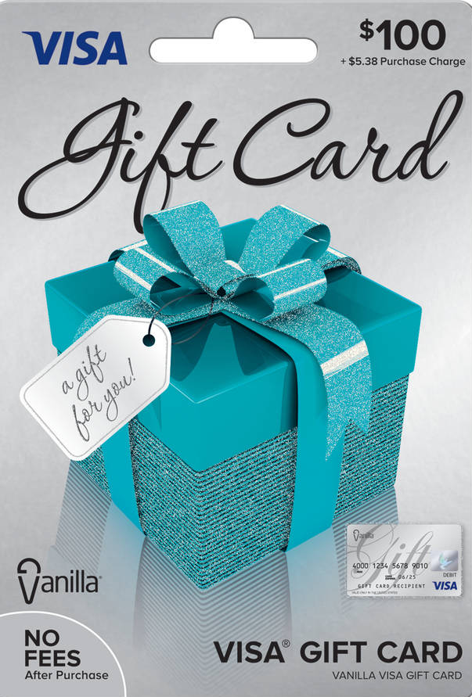
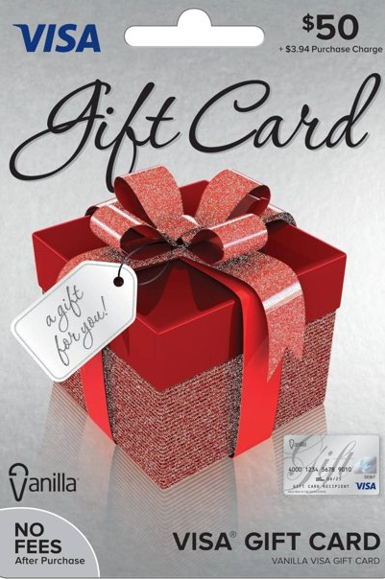
Homework
Survey
Relicensure points
Resources
utahjumpstart.org/2020Summit

Slide 38
Question of the Session
Answer to win a my529 Prize Pack!

